Slide 1

Mini Project-I (K24MCA18P) Odd Semester Session 2024-25 Health Tracker (A Digital Solution for Personal Health Management)
Team Leader: Anchal- 2426MCA325
Member:
Aditya Sharma- 2426MCA639
Project Supervisor:
Ms Divya Singhal
Assistant Professor

Slide 2
Content
Introduction
How it look?
Objective of the Project
Technology
Hardware Requirements
Software Requirements
Modules
Workflow
Reports
References

Slide 3
Introduction
A Health Tracker Web App is a digital platform designed to help monitor and manage various aspects of their health and wellness. The app typically provides tools for tracking fitness activities, blood sugar level, and other health-related metrics. These kind of web applications mainly use data, collected from manual entries or connected devices like smartwatches, fitness trackers, and phones to provide insights into a user’s overall health.

Slide 4
Literature Review
A health tracker web app involves synthesizing existing research, identifying gaps, and presenting a coherent narrative that informs the development of your application.

Slide 5
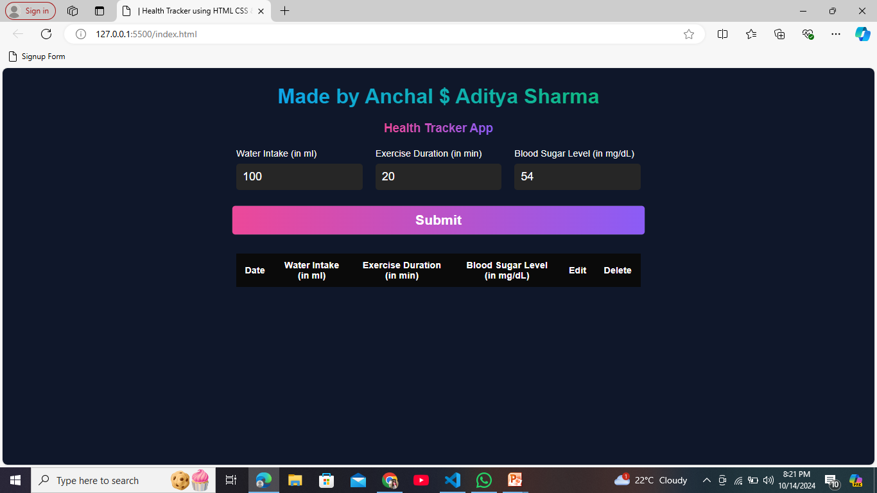
How it Look?

Slide 6
Objective of the Project
The objective of a Health Tracker Web App project is to create a user-friendly digital platform that enables individuals to monitor, manage, and improve their health and well-being through the use of tracking tools and data analytics. Specific objectives include:
Promote Healthy Lifestyle Habits
Integrate with Wearable Devices
Enable Remote Health Monitoring
Improve Health Outcomes

Slide 7
Technology (Hardware Requirements)
Server-side: Powerful multi-core CPU, RAM (16–32 GB), SSD storage.
Client-side: Compatible smartphones, tablets, or PCs .
Network: Stable internet connection for both backend and frontend users, with high-speed connectivity for real-time data syncing.

Slide 8
Software Requirements
HTML5: For structuring the web pages and ensuring compatibility across devices
.CSS3: For styling the application and making it responsive across different screen sizes (smartphones, tablets, desktops).
JS: For functionality of each module it helps in the backend process.

Slide 9
Modules
1. Health Data Visualization and Dashboard Module
This module offers a comprehensive view of the user's health metrics and progress.
Dashboard Overview:
A customizable dashboard where users can view all tracked data (e.g. sugar level, and water intake).

Slide 10
Modules
2. Activity Tracking Module
This module allows users to track their daily physical activities,
workouts, and exercise routines.
Physical Activity Monitoring:
Step counting, distance tracking, and active minutes.
Integration with wearable devices to track real-time data.
Exercise Logging:
Manual entry of workouts (e.g., running, cycling, gym workouts).

Slide 11
Workflow
User Registration: User accesses the app’s registration page.
Manual Data Input: They manually input data like sugar level, water intake and duration time of exercise.
Health Data Processing : The backend performs any necessary calculations (e.g., calculating calories burned, progress towards fitness goals).
Goal Setting and Recommendation : Users enter specific health goals (e.g., water intake in ml per day , sugar level, excercise 8 hours).

Slide 12
Reports
User Health Progress Reports :
Time Frame: Daily, Weekly, Monthly, Yearly
Goal Achievement Reports :
Goals Tracked: Fitness (e.g., steps, workout duration).
Comparative Reports :
Time-based Comparisons: Compare this week’s activity with last week or this month’s fitness activities with last month.

Slide 13
References
Web Articles & Blogs:
Statista (2023). Global fitness app market revenue from 2019 to 2027. Retrieved from Statista.
MobiHealthNews (2020). The impact of wearable technology on the future of health and fitness. Retrieved from MobiHealthNews.
Books & Journals:
Lee, S., & Lee, D. K. (2018). Healthcare wearable devices: An analysis of key factors for continuous usage intention.
A journal article focusing on the factors that influence the continued use of healthcare wearable devices for tracking health.

Slide 14
THANKYOU

